Slide 1
Chapter 2: Getting to Know Your Data
Data Objects and Attribute Types
Basic Statistical Descriptions of Data
Measuring Data Similarity and Dissimilarity
Summary

Slide 2


Types of Data Sets
Record
  Relational records
  Data matrix, e.g., numerical matrix, crosstabs
  Document data: text documents: term-frequency vector
  Transaction data
Graph and network
  World Wide Web
  Social or information networks
  Molecular Structures
Ordered
  Video data: sequence of images
  Temporal data: time-series
  Sequential Data: transaction sequences
  Genetic sequence data
Spatial, image and multimedia:
  Spatial data: maps
  Image data:
  Video data:

Slide 3
Important Characteristics of Structured Data
Dimensionality
  Curse of dimensionality
Sparsity
  Only presence counts
Resolution
  Patterns depend on the scale
Distribution
  Centrality and dispersion

Slide 4
Data Objects
Data sets are made up of data objects
A data object represents an entity
Examples:
  sales database: customers, store items, sales
  medical database: patients, treatments
  university database: students, professors, courses
Also called samples, examples, instances, data points, objects, tuples
Data objects are described by attributes
Database rows -> data objects; columns ->attributes

Slide 5
Attributes
Attribute (or dimensions, features, variables): a data field, representing a characteristic or feature of a data object
  E.g., customer_ID, name, address
Types:
  Nominal
  Binary
  Numeric: quantitative
    Interval-scaled
    Ratio-scaled

Slide 6
Attribute Types
Nominal: categories, states, or names
  Hair_color = {auburn, black, blond, brown, grey, red, white}
  marital status, occupation, ID numbers, zip codes
Binary
  Nominal attribute with only 2 states (0 and 1)
  Symmetric binary: both outcomes equally important
    e.g., gender
  Asymmetric binary: outcomes not equally important
    e.g., medical test (positive vs. negative)
    Convention: assign 1 to most important outcome (e.g., HIV positive)
Ordinal
  Values have a meaningful order (ranking), but magnitude between successive values is not known
  Size = {small, medium, large}, grades, army rankings

Slide 7
Numeric Attribute Types
Quantity (integer or real-valued)
Interval
    Measured on a scale of equal-sized units
    Values have order
      E.g., temperature in C˚or F˚, calendar dates
    No true zero-point
Ratio
    Inherent zero-point
    We can speak of values as being an order of magnitude larger than the unit of measurement (10 K˚ is twice as high as 5 K˚)
      e.g., temperature in Kelvin, length, counts, monetary quantities

Slide 8
Discrete vs. Continuous Attributes
Discrete Attribute
  Has only a finite or countably infinite set of values
    E.g., zip codes, profession, or the set of words in a collection of documents
  Sometimes, represented as integer variables
  Note: Binary attributes are a special case of discrete attributes
Continuous Attribute
  Has real numbers as attribute values
    E.g., temperature, height, or weight
  Practically, real values can only be measured and represented using a finite number of digits
  Continuous attributes are typically represented as floating-point variables

Slide 9

What is Data?
Collection of data objects and their attributes
An attribute is a property or characteristic of an object
  Examples: eye color of a person, temperature, etc.
  Attribute is also known as variable, field, characteristic, dimension, or feature
A collection of attributes describe an object
  Object is also known as record, point, case, sample, entity, or instance
Attributes
Objects

Slide 10
A More Complete View of Data
Data may have parts
The different parts of the data may have relationships
More generally, data may have structure
Data can be incomplete
We will discuss this in more detail later

Slide 11
Attribute Values
Attribute values are numbers or symbols assigned to an attribute for a particular object
Distinction between attributes and attribute values
  Same attribute can be mapped to different attribute values
    Example: height can be measured in feet or meters
  Different attributes can be mapped to the same set of values
    Example: Attribute values for ID and age are integers
    But properties of attribute values can be different

Slide 12
Types of Attributes
There are different types of attributes
  Nominal
    Examples: ID numbers, eye color, zip codes
  Ordinal
    Examples: rankings (e.g., taste of potato chips on a scale from 1-10), grades, height {tall, medium, short}
  Interval
    Examples: calendar dates, temperatures in Celsius or Fahrenheit.
  Ratio
    Examples: temperature in Kelvin, length, time, counts

Slide 13
Properties of Attribute Values
The type of an attribute depends on which of the following properties/operations it possesses:
  Distinctness: = ≠
  Order: < >
  Differences are + -
  meaningful :
  Ratios are * /
  meaningful
  Nominal attribute: distinctness
  Ordinal attribute: distinctness & order
  Interval attribute: distinctness, order & meaningful differences
  Ratio attribute: all 4 properties/operations

Slide 14
Difference Between Ratio and Interval
Is it physically meaningful to say that a temperature of 10 ° is twice that of 5° on
  the Celsius scale?
  the Fahrenheit scale?
  the Kelvin scale?
Consider measuring the height above average
  If Bill’s height is three inches above average and Bob’s height is six inches above average, then would we say that Bob is twice as tall as Bill?
  Is this situation analogous to that of temperature?

Slide 15
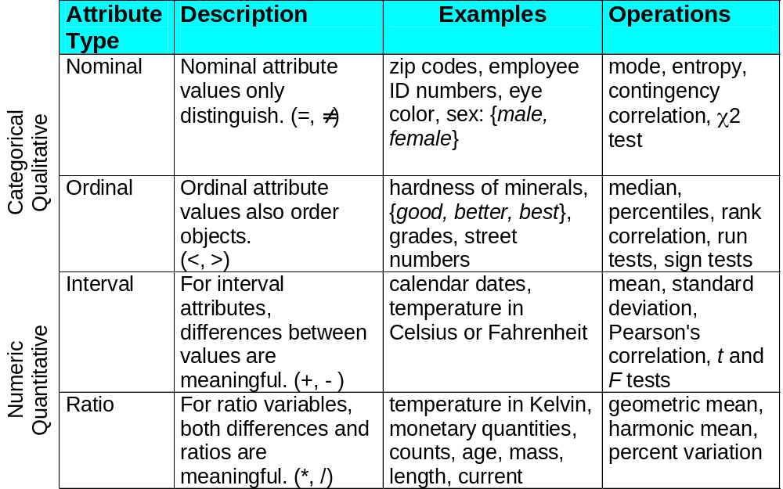
This categorization of attributes is due to S. S. Stevens

Slide 16
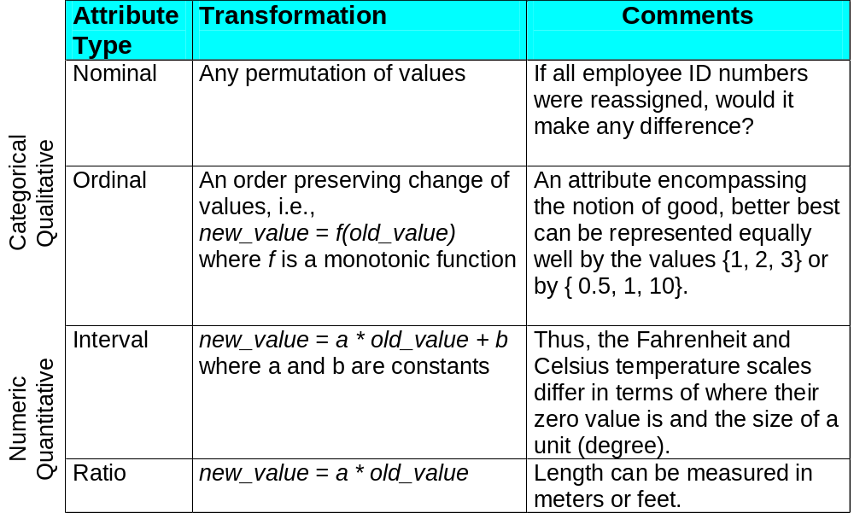
This categorization of attributes is due to S. S. Stevens

Slide 17
Discrete and Continuous Attributes
Discrete Attribute
  Has only a finite or countably infinite set of values
  Examples: zip codes, counts, or the set of words in a collection of documents
  Often represented as integer variables.
  Note: binary attributes are a special case of discrete attributes
Continuous Attribute
  Has real numbers as attribute values
  Examples: temperature, height, or weight.
  Practically, real values can only be measured and represented using a finite number of digits.
  Continuous attributes are typically represented as floating-point variables.

Slide 18
Chapter 2: Getting to Know Your Data
Data Objects and Attribute Types
Basic Statistical Descriptions of Data
Measuring Data Similarity and Dissimilarity
Summary

Slide 19
Basic Statistical Descriptions of Data
Motivation
  To better understand the data: central tendency, variation and spread
Data dispersion characteristics
  median, max, min, quantiles, outliers, variance, etc.
Numerical dimensions correspond to sorted intervals
  Data dispersion: analyzed with multiple granularities of precision
  Boxplot or quantile analysis on sorted intervals
Dispersion analysis on computed measures
  Folding measures into numerical dimensions
  Boxplot or quantile analysis on the transformed cube

Slide 20
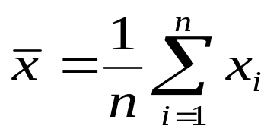


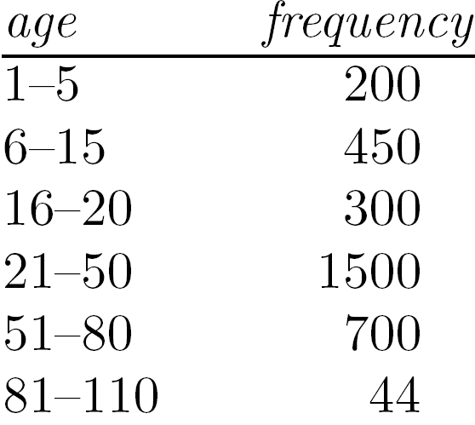
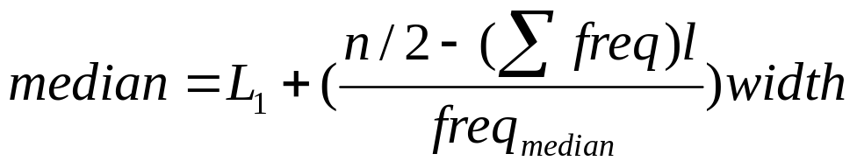
Measuring the Central Tendency
Mean (algebraic measure) (sample vs. population):
  Note: n is sample size and N is population size
  Weighted arithmetic mean:
  Trimmed mean: chopping extreme values
Median:
  Middle value if odd number of values, or average of the middle two values otherwise
  Estimated by interpolation (for grouped data):
Mode
  Value that occurs most frequently in the data
  Unimodal, bimodal, trimodal
  Empirical formula:

Slide 21



Symmetric vs. Skewed Data
Median, mean and mode of symmetric, positively and negatively skewed data
symmetric
positively skewed
negatively skewed
Data Mining: Concepts and Techniques

Slide 22


Measuring the Dispersion of Data
Quartiles, outliers and boxplots
  Quartiles: Q₁ (25th percentile), Q₃ (75th percentile)
  Inter-quartile range: IQR = Q₃ – Q₁
  Five number summary: min, Q₁, median, Q₃, max
  Boxplot: ends of the box are the quartiles; median is marked; add whiskers, and plot outliers individually
  Outlier: usually, a value higher/lower than 1.5 x IQR
Variance and standard deviation (sample: s, population: σ)
  Variance: (algebraic, scalable computation)
  Standard deviation s (or σ) is the square root of variance s² ⁽or σ²⁾

Slide 23
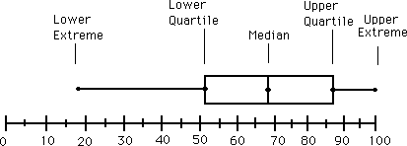
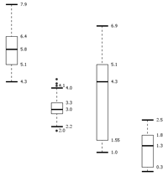
Boxplot Analysis
Five-number summary of a distribution
  Minimum, Q1, Median, Q3, Maximum
Boxplot
  Data is represented with a box
  The ends of the box are at the first and third quartiles, i.e., the height of the box is IQR
  The median is marked by a line within the box
  Whiskers: two lines outside the box extended to Minimum and Maximum
  Outliers: points beyond a specified outlier threshold, plotted individually

Slide 24

Visualization of Data Dispersion: 3-D Boxplots
Data Mining: Concepts and Techniques

Slide 25
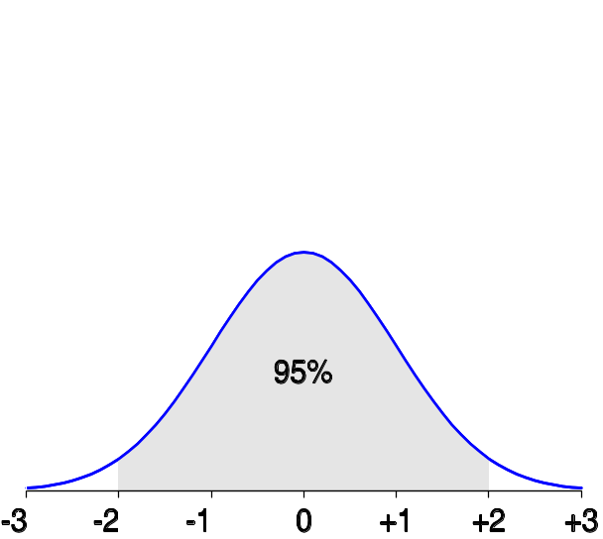
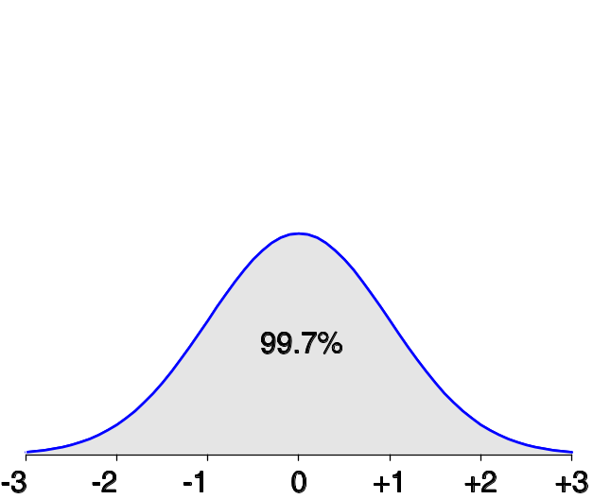
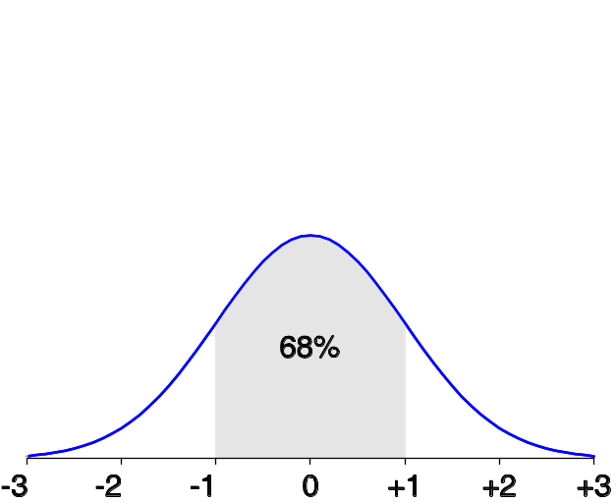
Properties of Normal Distribution Curve
The normal (distribution) curve
  From μ–σ to μ+σ: contains about 68% of the measurements (μ: mean, σ: standard deviation)
  From μ–2σ to μ+2σ: contains about 95% of it
  From μ–3σ to μ+3σ: contains about 99.7% of it

Slide 26
Graphic Displays of Basic Statistical Descriptions
Boxplot: graphic display of five-number summary
Histogram: x-axis are values, y-axis repres. frequencies
Quantile plot: each value x_{i} is paired with f_{i} indicating that approximately 100 f_{i} % of data are ≤ x_{i}
Quantile-quantile (q-q) plot: graphs the quantiles of one univariant distribution against the corresponding quantiles of another
Scatter plot: each pair of values is a pair of coordinates and plotted as points in the plane

Slide 27
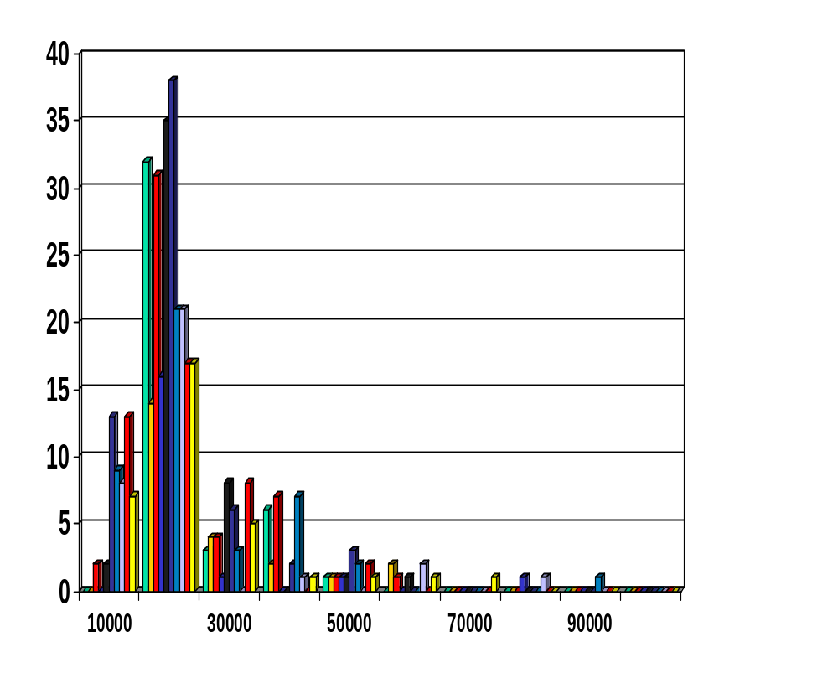
Histogram Analysis
Histogram: Graph display of tabulated frequencies, shown as bars
It shows what proportion of cases fall into each of several categories
Differs from a bar chart in that it is the area of the bar that denotes the value, not the height as in bar charts, a crucial distinction when the categories are not of uniform width
The categories are usually specified as non-overlapping intervals of some variable. The categories (bars) must be adjacent

Slide 28
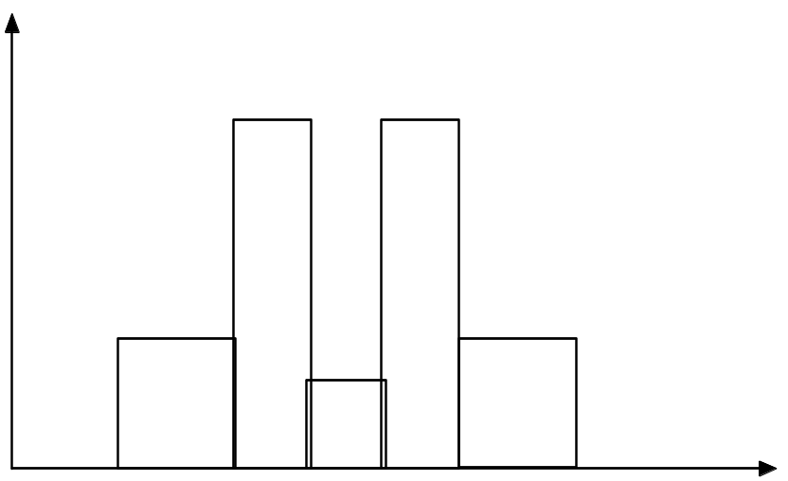
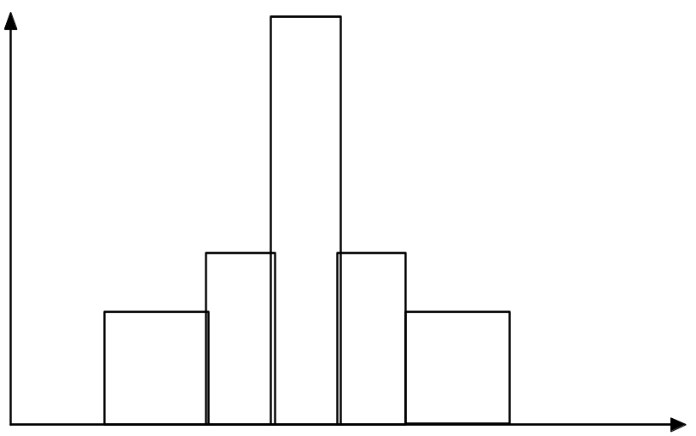
Histograms Often Tell More than Boxplots
The two histograms shown in the left may have the same boxplot representation
  The same values for: min, Q1, median, Q3, max
But they have rather different data distributions

Slide 29
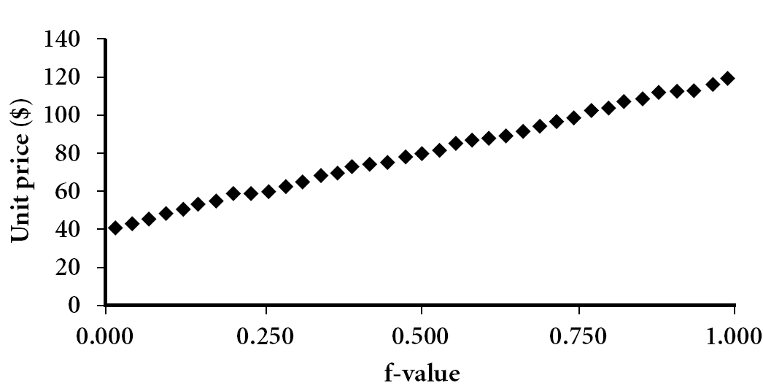
Quantile Plot
Displays all of the data (allowing the user to assess both the overall behavior and unusual occurrences)
Plots quantile information
  For a data x_{i} data sorted in increasing order, f_{i} indicates that approximately 100 f_{i}% of the data are below or equal to the value x_{i}
Data Mining: Concepts and Techniques

Slide 30
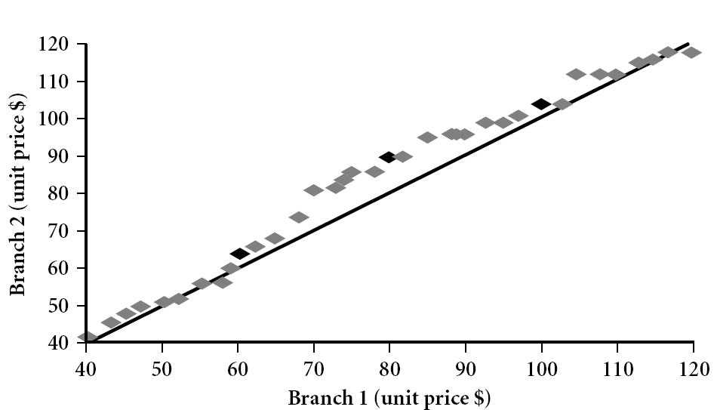
Quantile-Quantile (Q-Q) Plot
Graphs the quantiles of one univariate distribution against the corresponding quantiles of another
View: Is there is a shift in going from one distribution to another?
Example shows unit price of items sold at Branch 1 vs. Branch 2 for each quantile. Unit prices of items sold at Branch 1 tend to be lower than those at Branch 2
Notes:
Note: We need to label the dark plotted points as Q1, Median, Q3 – that would help in understanding this graph.
Tell audience: There is a shift in distribution of branch 1 WRT branch 2 in that the unit prices of items sold at branch 1 tend to be lower than those at branch 2.

Slide 31
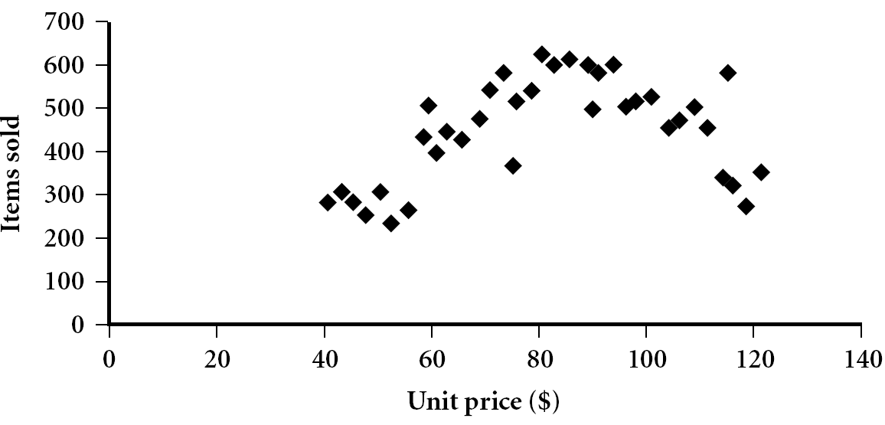
Scatter plot
Provides a first look at bivariate data to see clusters of points, outliers, etc
Each pair of values is treated as a pair of coordinates and plotted as points in the plane

Slide 32


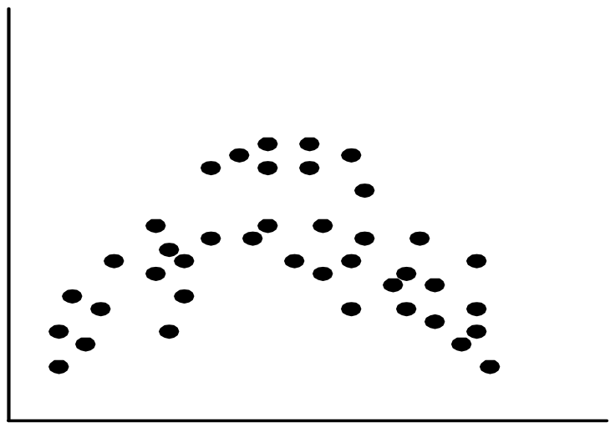
Positively and Negatively Correlated Data
The left half fragment is positively correlated
The right half is negative correlated

Slide 33


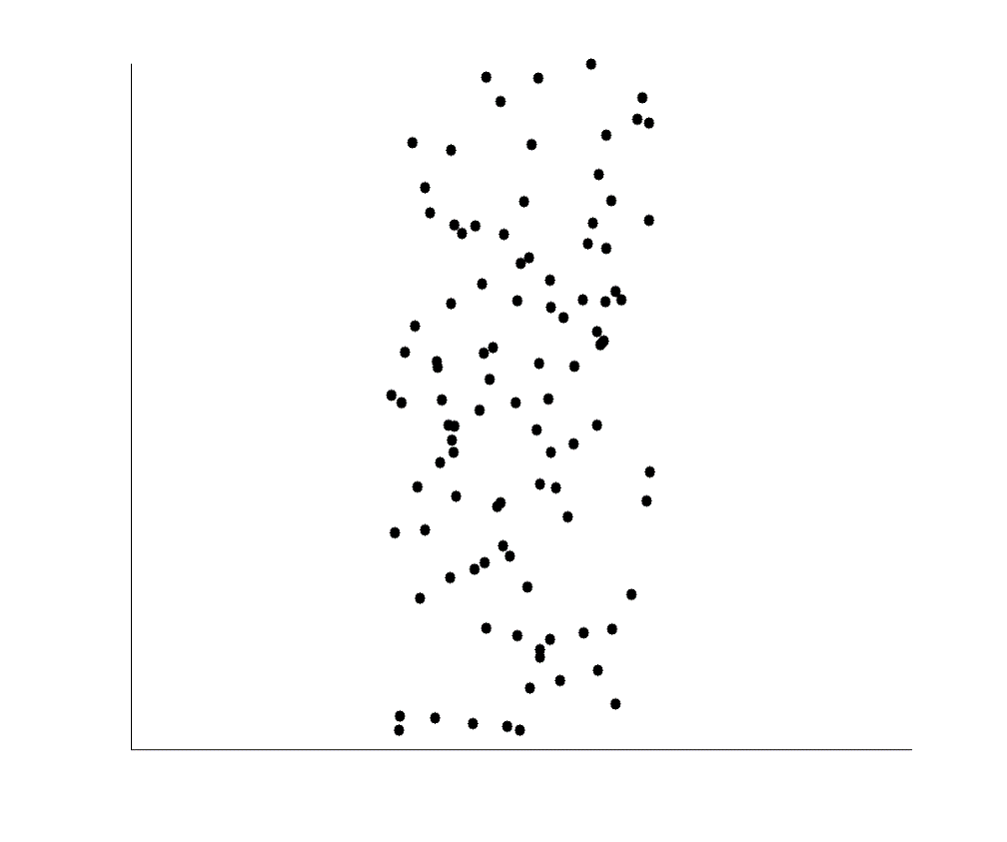
Uncorrelated Data

Slide 34
Chapter 2: Getting to Know Your Data
Data Objects and Attribute Types
Basic Statistical Descriptions of Data
Measuring Data Similarity and Dissimilarity
Summary

Slide 35
Chapter 2: Getting to Know Your Data
Data Objects and Attribute Types
Basic Statistical Descriptions of Data
Data Visualization
Measuring Data Similarity and Dissimilarity
Summary

Slide 36
Similarity and Dissimilarity
Similarity
  Numerical measure of how alike two data objects are
  Value is higher when objects are more alike
  Often falls in the range [0,1]
Dissimilarity (e.g., distance)
  Numerical measure of how different two data objects are
  Lower when objects are more alike
  Minimum dissimilarity is often 0
  Upper limit varies
Proximity refers to a similarity or dissimilarity

Slide 37


Data Matrix and Dissimilarity Matrix
Data matrix
  n data points with p dimensions
  Two modes
Dissimilarity matrix
  n data points, but registers only the distance
  A triangular matrix
  Single mode

Slide 38

Proximity Measure for Nominal Attributes
Can take 2 or more states, e.g., red, yellow, blue, green (generalization of a binary attribute)
Method 1: Simple matching
  m: # of matches, p: total # of variables
Method 2: Use a large number of binary attributes
  creating a new binary attribute for each of the M nominal states

Slide 39
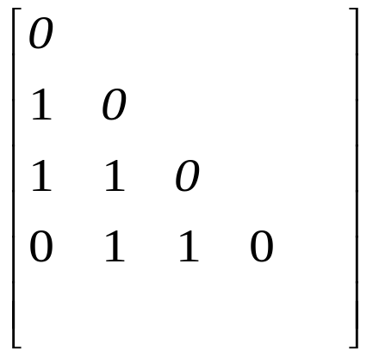
Object Identifier | Test 1 (Nominal) | Test 2 (ordinal) | Test 3 (Numeric)
1 | Code A | Excellent | 45
2 | Code B | Fair | 22
3 | Code C | Good | 64
4 | Code A | Excellent | 28

Slide 40
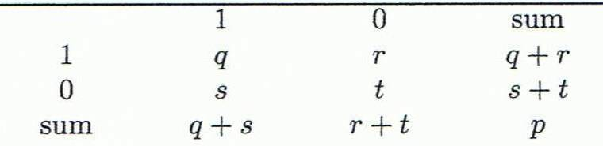
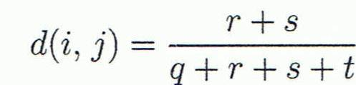
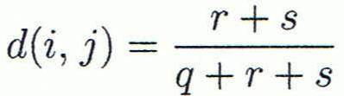

Proximity Measure for Binary Attributes
Object j
A contingency table for binary data
Distance measure for symmetric binary variables:
Distance measure for asymmetric binary variables:
Jaccard coefficient (similarity measure for asymmetric binary variables):
Object i
Note: Jaccard coefficient is the same as “coherence”:

Slide 41


Dissimilarity between Binary Variables
Example
  Gender is a symmetric attribute
  The remaining attributes are asymmetric binary
  Let the values Y and P be 1, and the value N 0

Slide 42
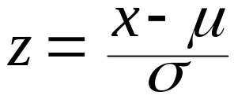
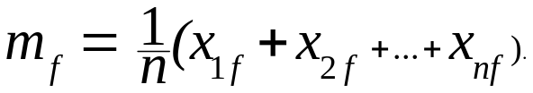
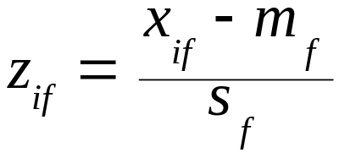
Standardizing Numeric Data
Z-score:
  X: raw score to be standardized, μ: mean of the population, σ: standard deviation
  the distance between the raw score and the population mean in units of the standard deviation
  negative when the raw score is below the mean, “+” when above
An alternative way: Calculate the mean absolute deviation
  where
  standardized measure (z-score):
Using mean absolute deviation is more robust than using standard deviation

Slide 43
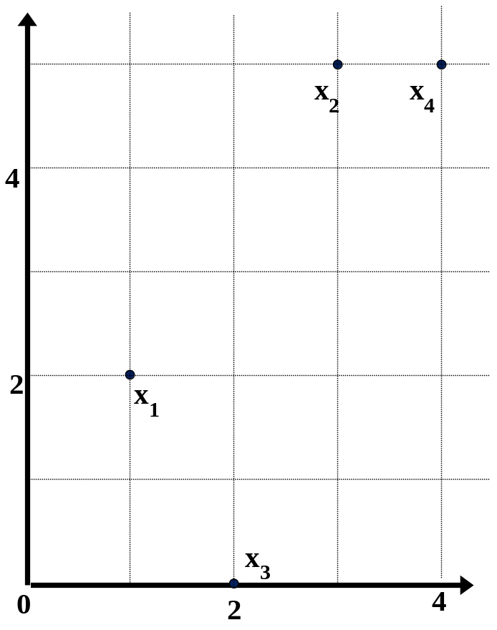
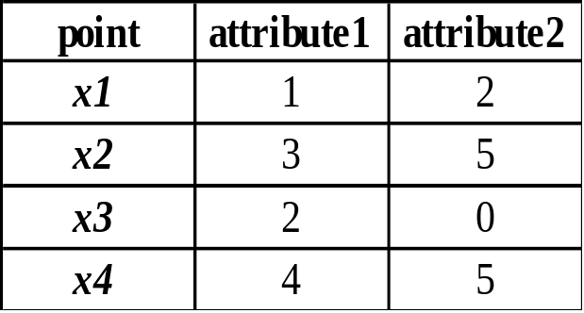
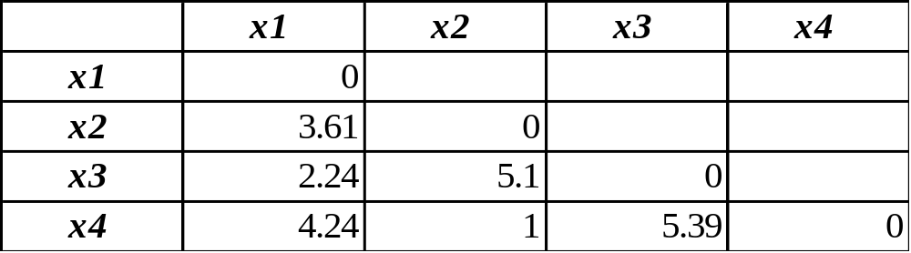
Example:
Data Matrix and Dissimilarity Matrix
Data Matrix
Dissimilarity Matrix
(with Euclidean Distance)

Slide 44
Distance on Numeric Data: Minkowski Distance
Minkowski distance: A popular distance measure
  where i = (x_{i1}, x_{i2}, …, x_{ip}) and j = (x_{j1}, x_{j2}, …, x_{jp}) are two p-dimensional data objects, and h is the order (the distance so defined is also called L-h norm)
Properties
  d(i, j) > 0 if i ≠ j, and d(i, i) = 0 (Positive definiteness)
  d(i, j) = d(j, i) (Symmetry)
  d(i, j) ≤ d(i, k) + d(k, j) (Triangle Inequality)
A distance that satisfies these properties is a metric

Slide 45


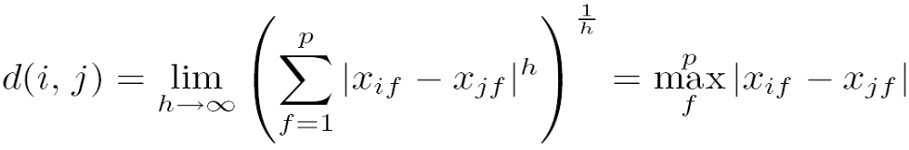
Special Cases of Minkowski Distance
h = 1: Manhattan (city block, L₁ norm) distance
  E.g., the Hamming distance: the number of bits that are different between two binary vectors
h = 2: (L₂ norm) Euclidean distance
h → ∞. “supremum” (L_{max} norm, L∞ norm) distance.
  This is the maximum difference between any component (attribute) of the vectors

Slide 46
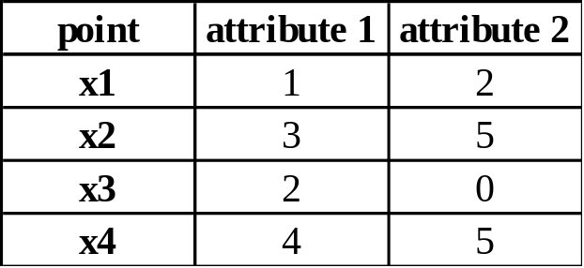
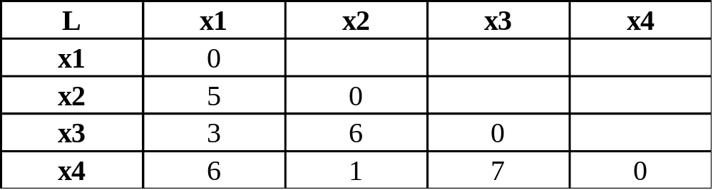
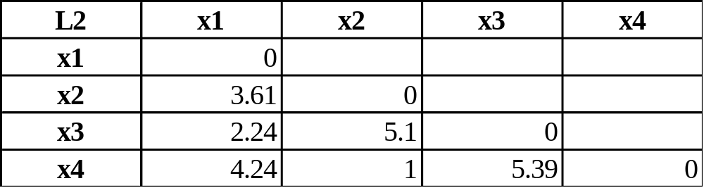
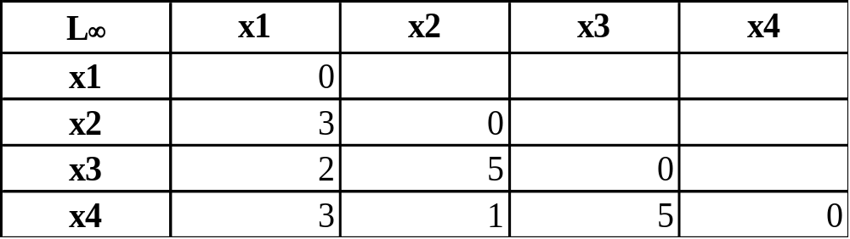
Example: Minkowski Distance
Dissimilarity Matrices
Manhattan (L₁)
Euclidean (L₂)
Supremum

Slide 47


Ordinal Variables
An ordinal variable can be discrete or continuous
Order is important, e.g., rank
Can be treated like interval-scaled
  replace x_{if} by their rank
  map the range of each variable onto [0, 1] by replacing i-th object in the f-th variable by
  compute the dissimilarity using methods for interval-scaled variables

Slide 48

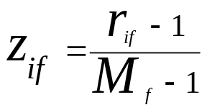
Attributes of Mixed Type
A database may contain all attribute types
  Nominal, symmetric binary, asymmetric binary, numeric, ordinal
One may use a weighted formula to combine their effects
  f is binary or nominal:
    d_{ij}^{(f)} = 0 if x_{if} = x_{jf} , or d_{ij}^{(f)} = 1 otherwise
  f is numeric: use the normalized distance
  f is ordinal
    Compute ranks r_{if} and
    Treat z_{if} as interval-scaled

Slide 49
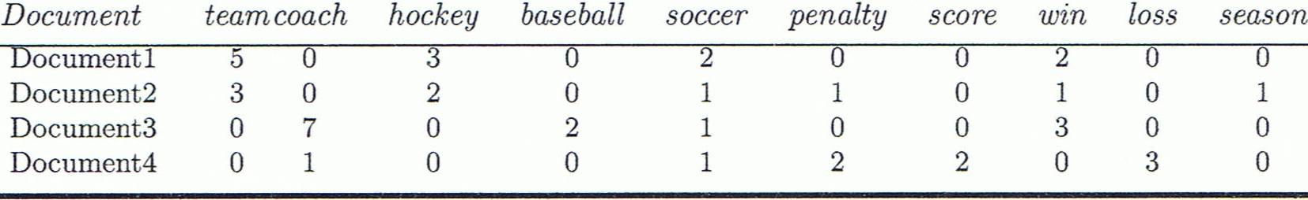
Cosine Similarity
A document can be represented by thousands of attributes, each recording the frequency of a particular word (such as keywords) or phrase in the document
Other vector objects: gene features in micro-arrays, …
Applications: information retrieval, biologic taxonomy, gene feature mapping, ...
Cosine measure: If d₁ and d₂ are two vectors (e.g., term-frequency vectors), then
cos(d₁, d₂) = (d₁ • d₂) /||d₁|| ||d₂||
  where • indicates vector dot product, ||d||: the length of vector d

Slide 50
Example: Cosine Similarity
cos(d₁, d₂) = (d₁ • d₂) /||d₁|| ||d₂||
  where • indicates vector dot product, ||d|: the length of vector d
Ex: Find the similarity between documents 1 and 2
  d₁ = (5, 0, 3, 0, 2, 0, 0, 2, 0, 0)
  d₂ = (3, 0, 2, 0, 1, 1, 0, 1, 0, 1)
  d₁•d₂ = 5*3+0*0+3*2+0*0+2*1+0*1+0*1+2*1+0*0+0*1 = 25
  ||d₁||= (5*5+0*0+3*3+0*0+2*2+0*0+0*0+2*2+0*0+0*0)^{0.5}=(42)^{0.5} = 6.481
  ||d₂||= (3*3+0*0+2*2+0*0+1*1+1*1+0*0+1*1+0*0+1*1)^{0.5}=(17)^{0.5} = 4.12
  cos(d₁, d₂ ) = 0.94

Slide 51
Chapter 2: Getting to Know Your Data
Data Objects and Attribute Types
Basic Statistical Descriptions of Data
Data Visualization
Measuring Data Similarity and Dissimilarity
Summary

Slide 52
Summary
Data attribute types: nominal, binary, ordinal, interval-scaled, ratio-scaled
Many types of data sets, e.g., numerical, text, graph, Web, image
Gain insight into the data by:
  Basic statistical data description: central tendency, dispersion, graphical displays
  Data visualization: map data onto graphical primitives
  Measure data similarity
Above steps are the beginning of data preprocessing
Many methods have been developed but still an active area of research

Slide 53
References
W. Cleveland, Visualizing Data, Hobart Press, 1993
T. Dasu and T. Johnson. Exploratory Data Mining and Data Cleaning. John Wiley, 2003
U. Fayyad, G. Grinstein, and A. Wierse. Information Visualization in Data Mining and Knowledge Discovery, Morgan Kaufmann, 2001
L. Kaufman and P. J. Rousseeuw. Finding Groups in Data: an Introduction to Cluster Analysis. John Wiley & Sons, 1990.
H. V. Jagadish, et al., Special Issue on Data Reduction Techniques. Bulletin of the Tech. Committee on Data Eng., 20(4), Dec. 1997
D. A. Keim. Information visualization and visual data mining, IEEE trans. on Visualization and Computer Graphics, 8(1), 2002
D. Pyle. Data Preparation for Data Mining. Morgan Kaufmann, 1999
S. Santini and R. Jain,” Similarity measures”, IEEE Trans. on Pattern Analysis and Machine Intelligence, 21(9), 1999
E. R. Tufte. The Visual Display of Quantitative Information, 2nd ed., Graphics Press, 2001
C. Yu , et al., Visual data mining of multimedia data for social and behavioral studies, Information Visualization, 8(1), 2009

